Slide 1
Data Mining and Machine Learning for Business
DSCI 5240

Slide 2
What is data mining/business analytics?
Domain Knowledge
Internal / External Data
Domain Knowledge
Domain Knowledge
Identify Problem
Data Collection
Data Preparation
Explore
Modeling
Communicating
Coding
Visual / Coding
Model / Coding
Visual / Coding
Generating actionable business insights from data
An iterative process

Slide 3
What is machine learning?
“A field of inquiry devoted to understanding and building methods that 'learn', that is, methods that leverage data to improve performance on some set of tasks.” (Wikipediae)
“ML is the process of training a piece of software, called a model, to make useful predictions from data.” – Google AI
Why machine learning?
Using data, machine learning can:
Find new ways for previously complicated tasks
Make it easy to scale tasks
Make unprogrammable tasks possible

Slide 4
Supervised learning
The correct answers (labels: Y) are given in the data
Train a model to find the mapping (model) between features (Xs) and Y using data
Analogy:
Students are given past questions and correct answers
Students learn by studying the questions and answers
Student can answer new questions based on training

Slide 5
Key components of Supervised Learning
Data
Training
Model
Evaluation
Prediction/
Inference

Slide 6
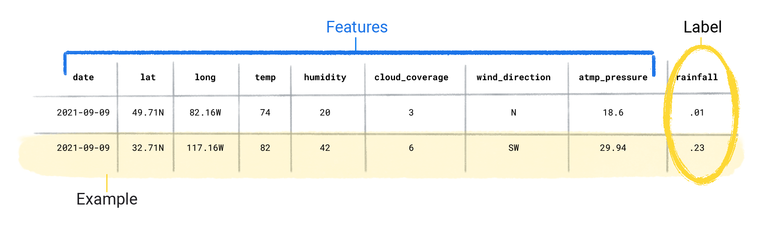
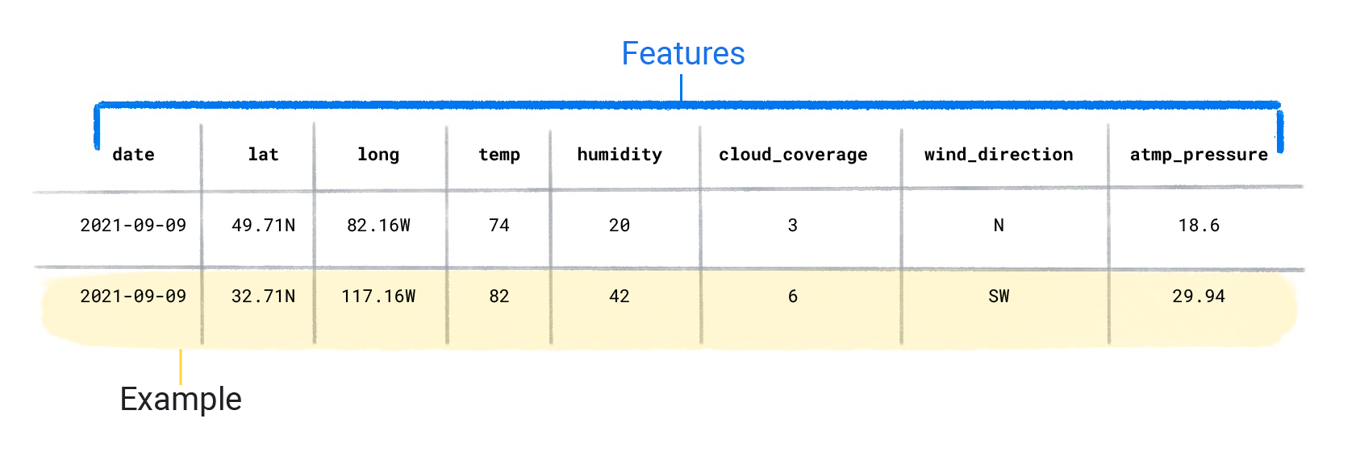
Data
Features: attributes, fields, independent variables, predictors, explanatory variables
Label: dependent variable, target, response

Slide 7
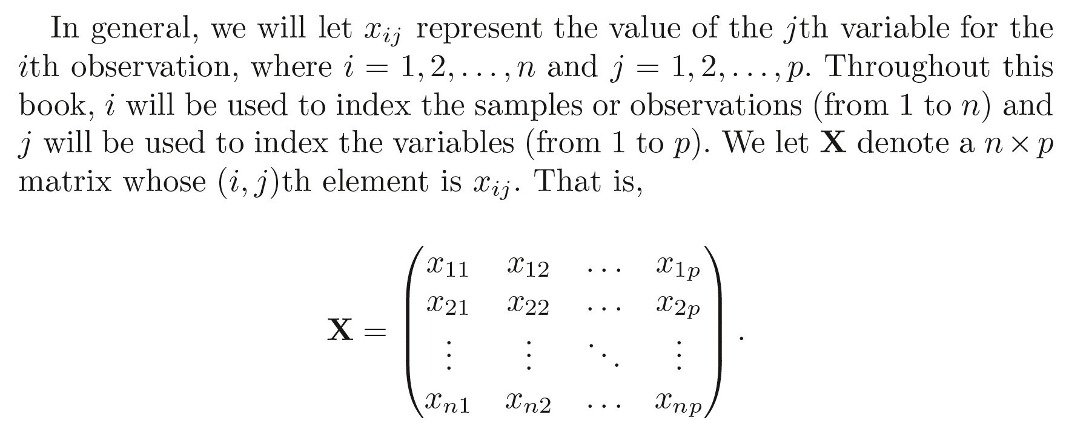
Data - Notation
You can visualize X as a spreadsheet of numbers with n rows and p columns

Slide 8
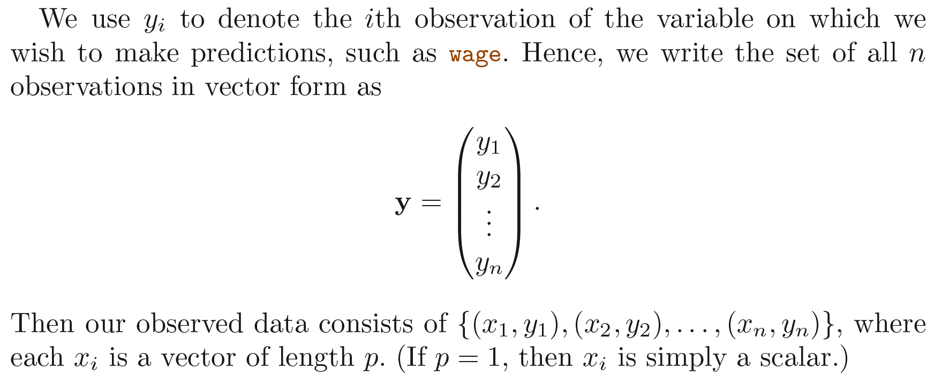
Data - Notation

Slide 9
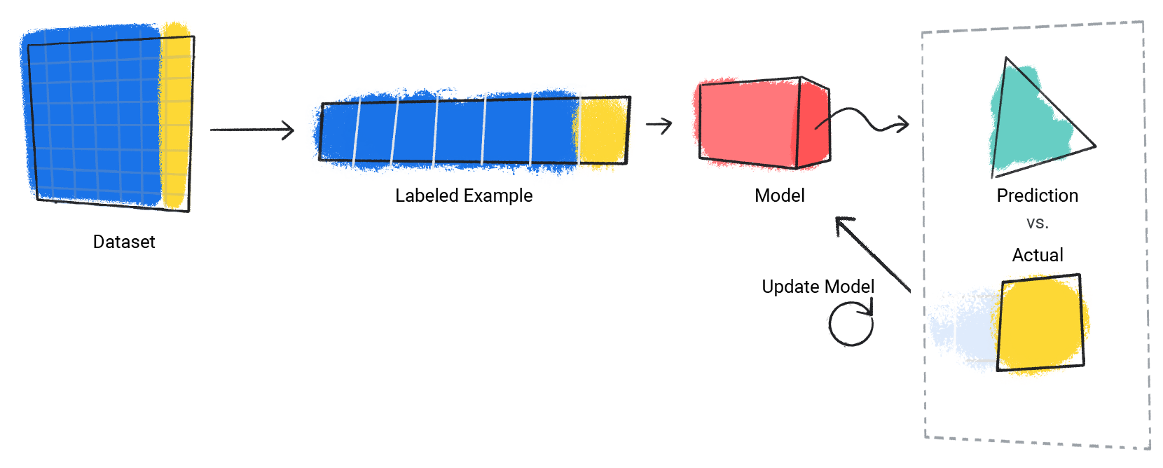
Training
To find the best solution for predicting Y from Xs
By comparing prediction with actual values, the model keeps updating itself
Finally, it finds the best model to make predictions
Source: Google AI

Slide 10
Model
A mathematical mapping between features (Xs) to output labels (Y)
Most often seen models:
Regression
Logistic regression
Tree-based methods
Support vector machine
Neural Networks
Generative models
…
We configure
Parameters
Features

Slide 11
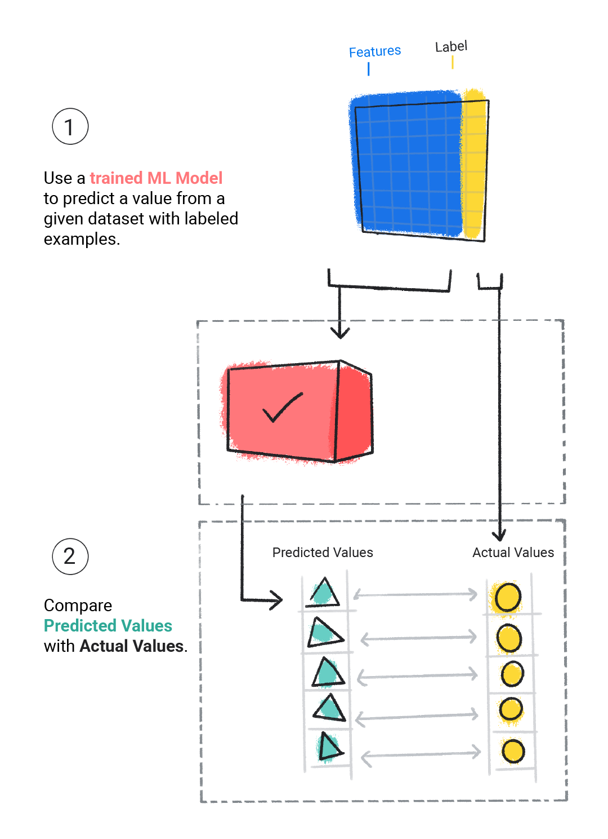
Evaluation
Evaluate the performance of models to find the best one

Slide 12
Prediction vs. Inference
Prediction: main goal is to make accurate prediction
E.g., A direct marketing campaign that only cares about to make accurate prediction about which customer will respond
Inference: to understand how Y changes when X changes
E.g., the problem of advertising budget allocation may involve questions like: which media generate the biggest boost in sales? How much increase in sales is associated with a given increase in TV advertising?
Focus of projects: prediction, inference or both
Different methods may be appropriate for different focus

Slide 13
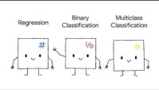
Regression vs classification
In a regression problem, Y is quantitative (e.g., continuous variables such as price, wage)
In a classification problem, Y is qualitative, taking values in a finite set (e.g., respond/not respond, win/lose, choice of brands, cancer types)

Slide 14
Unsupervised learning
No correct answers (labels), just a set of features measured on a set of samples
Objective is more fuzzy – find groups of samples that behave similarly, features that behave similarly, etc.
Difficult to know how well you are doing
The most common use
Clustering: cluster data into similar groups based on features

Slide 15
Gene Expression
The data
64 cell lines
Each cell line has 6830 gene expression measurements
Associated with 14 cancer types
We need to
Identify whether there are groups, or clusters among the cell lines based on their gene expression measurements

Slide 16
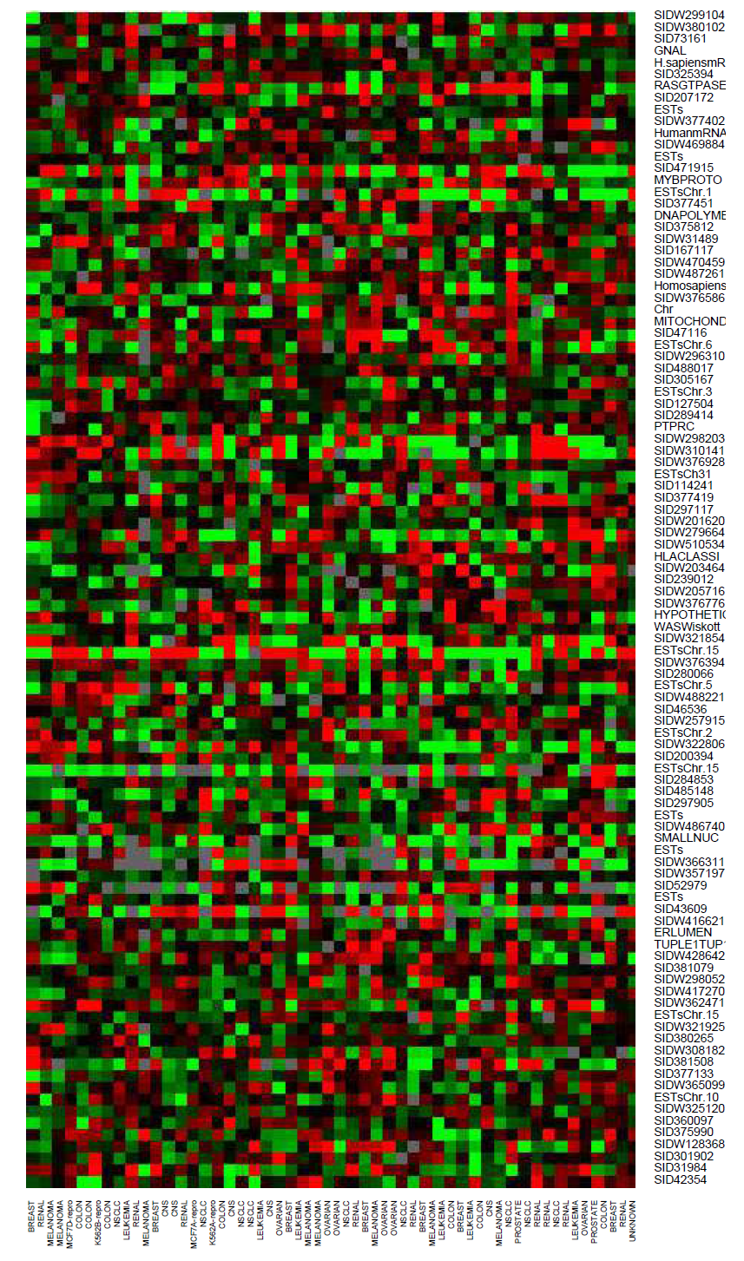
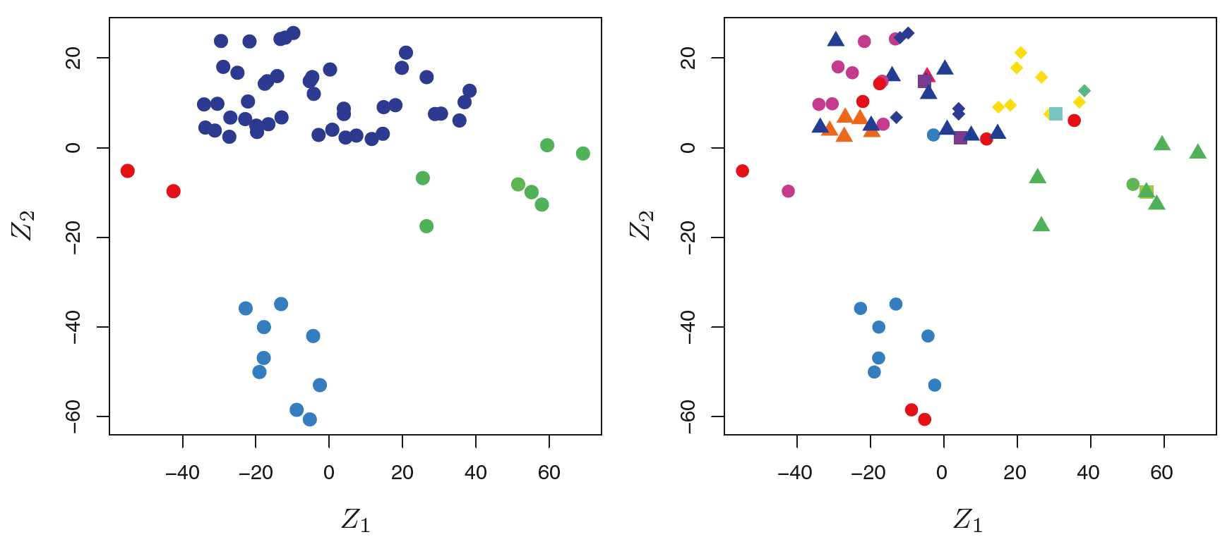
Example – Gene Expression

Slide 17
Our philosophy
Optimizing algorithms and theoretical properties of statistical models are not our primary interest – it is not necessary to have the skills to construct the machine
However, it is important to understand the idea behind each method, in order to know when and how to use them
One has to understand simpler methods first to grasp more sophisticated ones
To apply methods to real-world problems

Slide 18
Get to know Python

